Slide 1
Digital Rewards
NASCAR, NHL, NFL

Slide 2
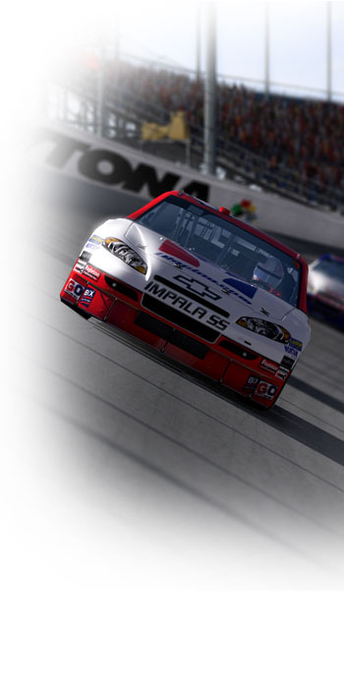


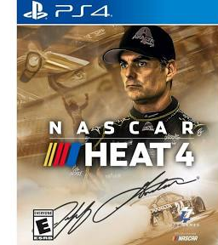
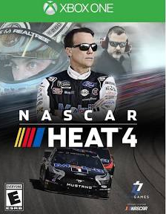
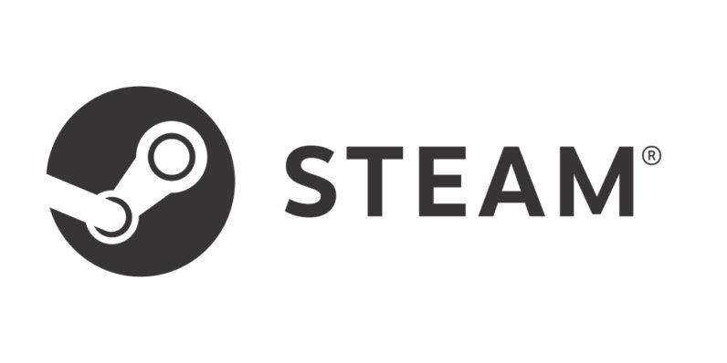
NASCAR Digital Rewards (Gaming)
There are two games that eNASCAR uses to simulate NASCAR racing:
NASCAR Heat 4 – Officially Licensed NASCAR game, available on Xbox, PS4, and PC (Steam)
iRacing – Subscription based racing platform, not dedicated to NASCAR but much more popular among gamers than Heat 4
Free subscriptions to iRacing, or free copies of Heat 4 (via digital download) would be great rewards
A nice sweep could include a free PS4, Xbox, and/or high-end steering wheel controllers; many options here

Slide 3



NASCAR Digital Rewards (OTT)
TrackPass is NASCAR’s flagship OTT service and can be found on NBC Sports Gold. A free subscription to these services would be an easy sell to NASCAR fans.
We could also A/B split these digital rewards with gaming digital rewards to see which are more enticing, and also to better measure the relationships between eNASCAR and traditional NASCAR fans.
For example, if after watching an eNASCAR event a viewer is presented with the option to a) have a game for free or b) have a year of TrackPass for free, we could see which direction eNASCAR was driving fans, and by how much. Those who chose option B could be considered eNASCAR fans converted to traditional NASCAR fans.

Slide 4

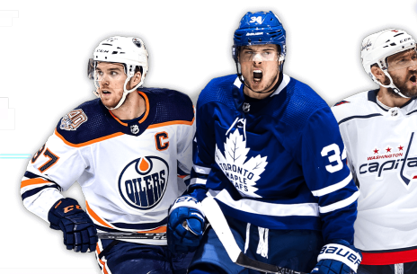
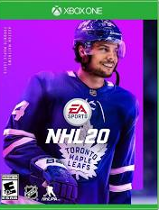
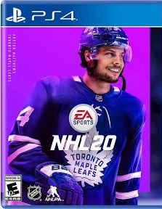

NHL Digital Rewards
Just like NASCAR, the NHL has a lineup of gaming and OTT options, each of which presents an opportunity to provide a digital reward. NHL games also feature microtransactions via EA’s Hockey Ultimate Team feature, allowing for a more diverse set of digital gaming rewards.
Some games feature paid upgrades that could be provided to individuals that own the game but may not have purchased any upgrades yet. These are known as “DLC,” or downloadable content, and are different than microtransactions.

Slide 5
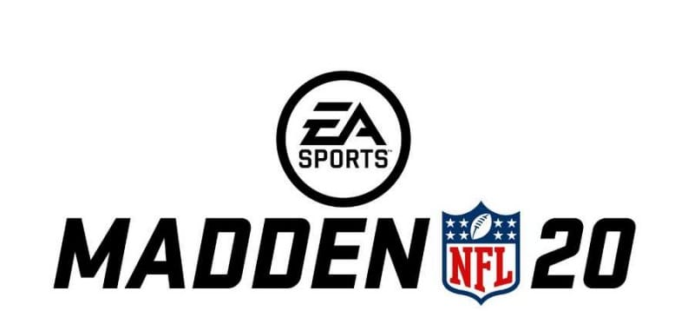
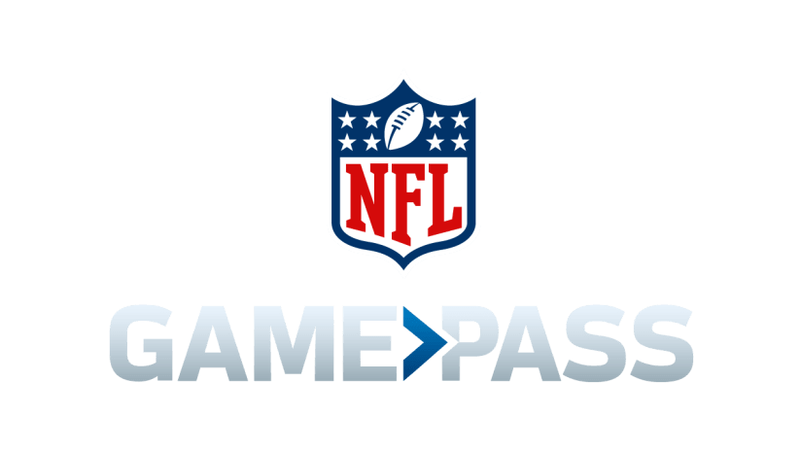
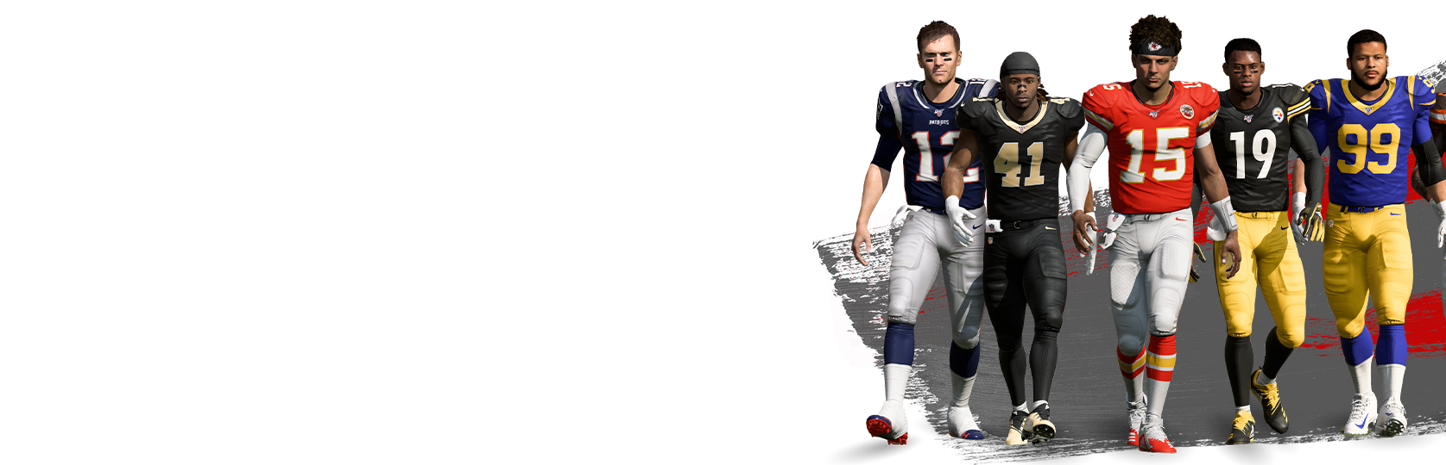

NFL Digital Rewards
The NFL’s digital lineup is quite similar to the NHL’s, especially given that EA owns the rights to produce games for both leagues. Once again microtransactions are featured heavily as a mechanism to drive continued revenue after the game has been purchased via EA’s Madden Ultimate Team feature. Providing digital incentives through Ultimate Team would be very enticing to Madden fans.
GamePass would also be an excellent option as a reward and we could A/B its success as an incentive against video games to learn additional insights about our users’ preferences.
(Madden Ultimate Team)

Slide 6
Mix & Match for Testing
Provide a selection of incentives to see which are most likely to succeed and also track what individuals decide to choose to learn more about their digital habits. For example:
Game reward only: NHL 20 download code for Xbox, PS4, or PC
OTT reward only: 6 Months free subscription to NHL Live
OTT/Game mix: $10 of in-game currency for NHL 20 Hockey Ultimate Team, and 3 months of NHL Live
Since all goods are digital, there shouldn’t be a very high cost associated with delivery. Ensuring that each reward was roughly of equal monetary value would increase the validity of any analysis we perform on incentive choice.
Mark
32yrs
Joe
58yrs
Paula
19yrs

